Slide 1
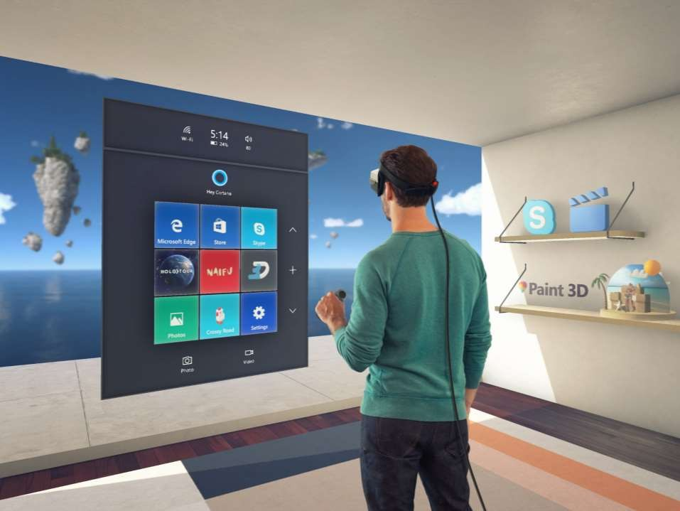

Slide 2

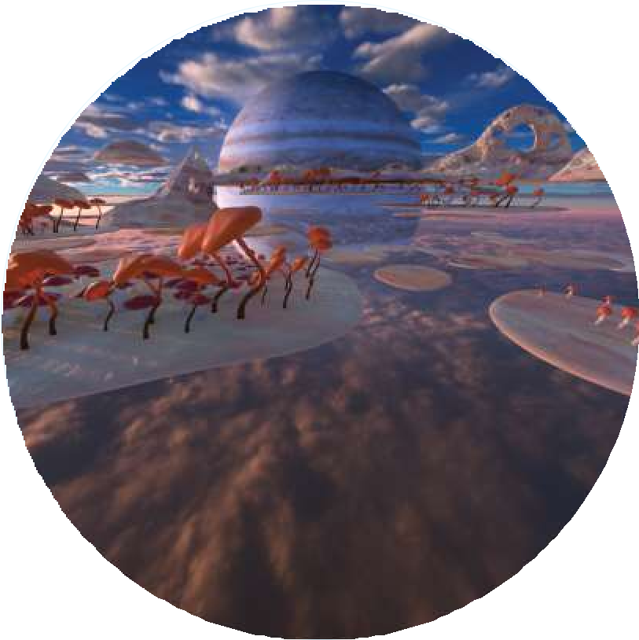
PHYSICAL REALITY
DIGITAL REALITY

Slide 3
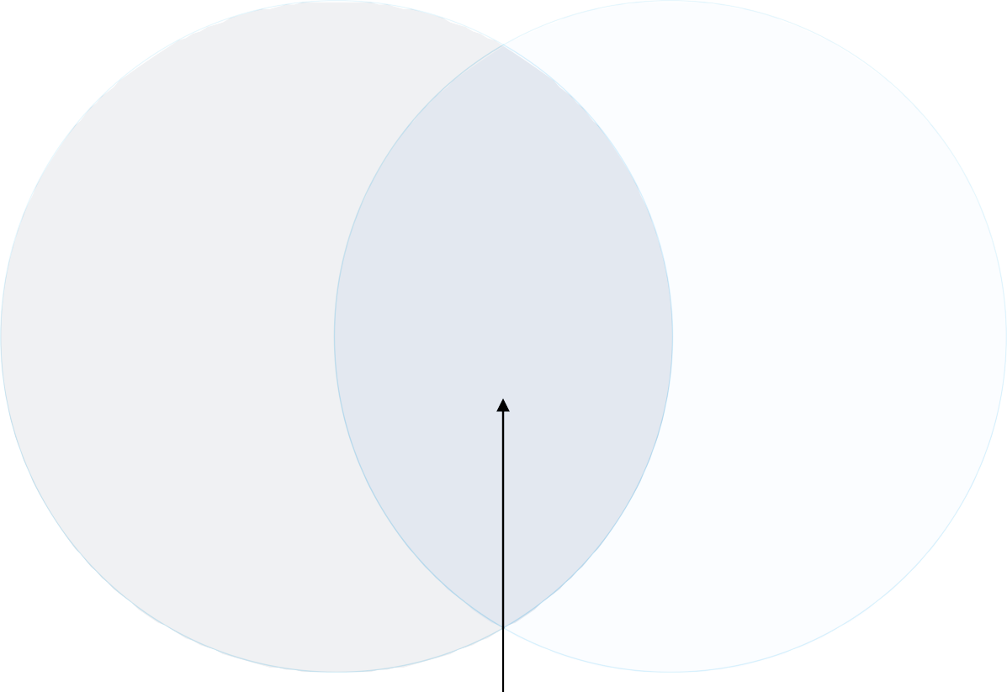
PHYSICAL REALITY
DIGITAL REALITY
MIXED REALITY

Slide 4

Mixed reality spectrum
Mixed reality blends the physical and digital worlds to produce new environments where physical and digital objects co- exist and can be interacted with as if all of them were real.
MIXED REALITY (MR)
PHYSICAL REALITY
DIGITAL
REALITY
AR today
VR today
Windows Mixed Reality – Holographic headsets (see-through)
Windows Mixed Reality – Immersive headsets (occluded)
Windows Mixed Reality requires
Perception/environment awareness
Any mix of people, places or things

Slide 5
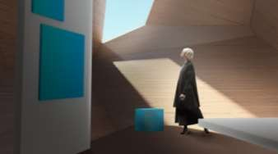
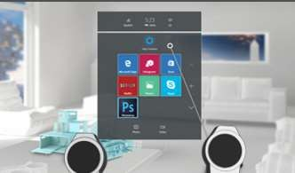
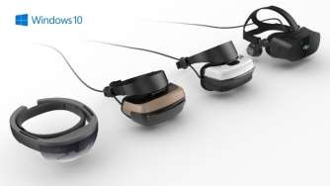
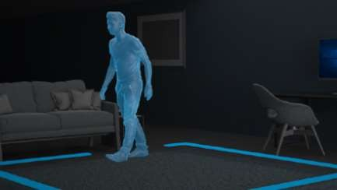

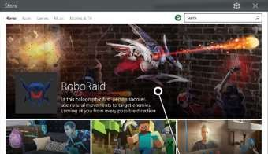
What makes us different?

Slide 6
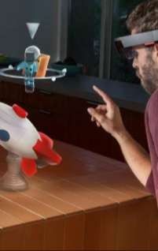
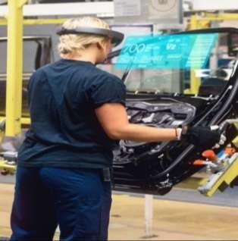

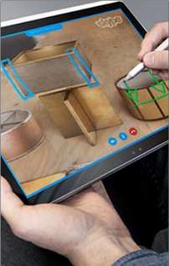
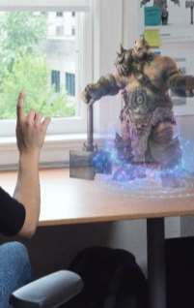
Build great things
Creation & Design
Assembly & Manufacturing
Training & Development
Communication & Understanding
Entertainment & Engagement

Slide 7



Mixed Reality Building Blocks

Slide 8
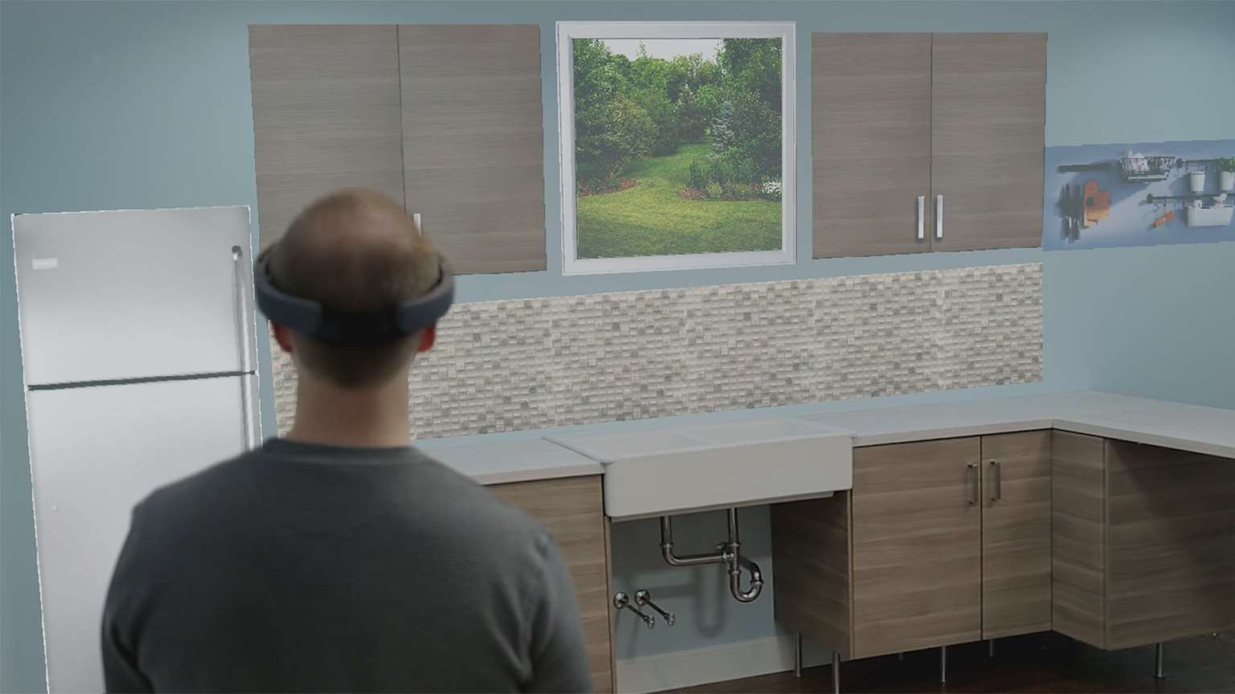



Slide 9
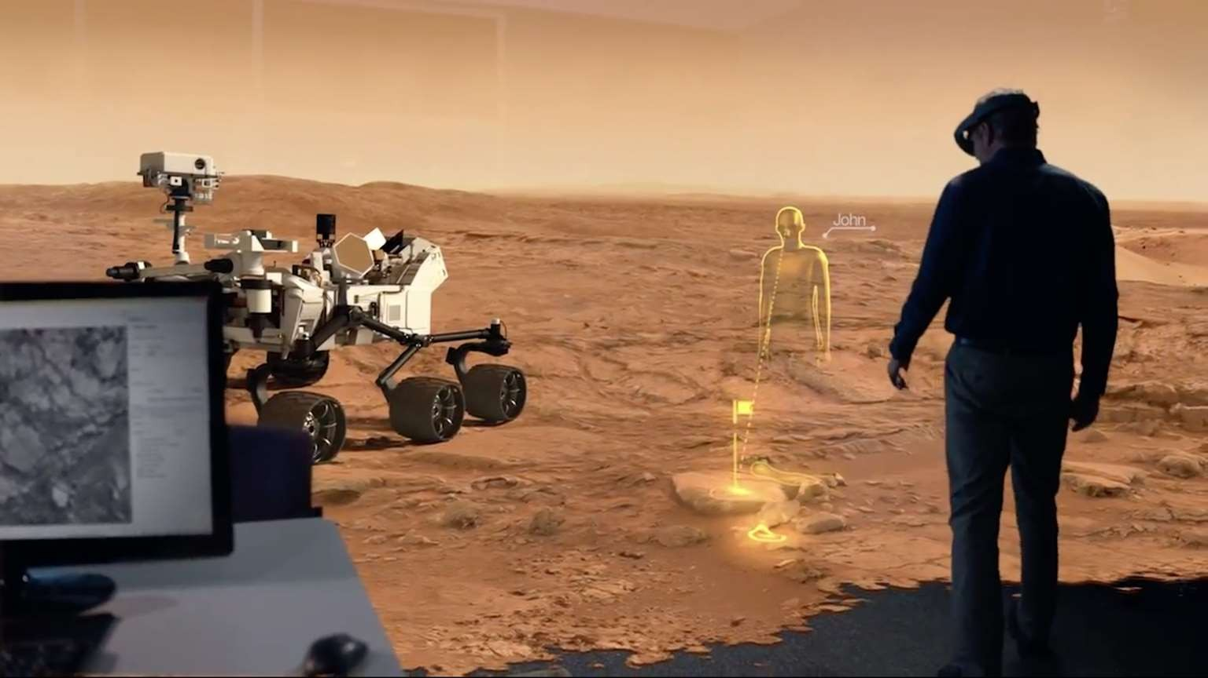



Slide 10




Slide 11
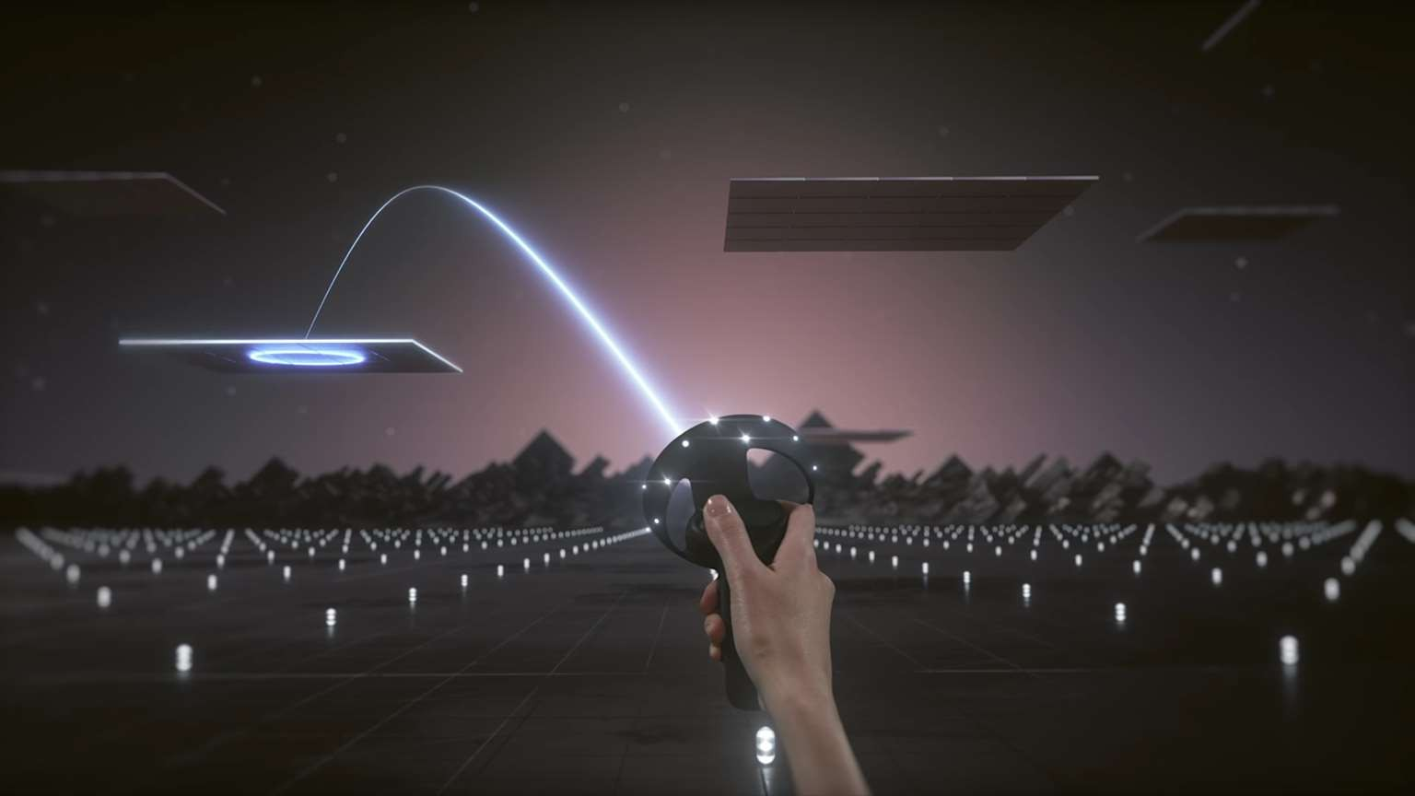



Slide 12
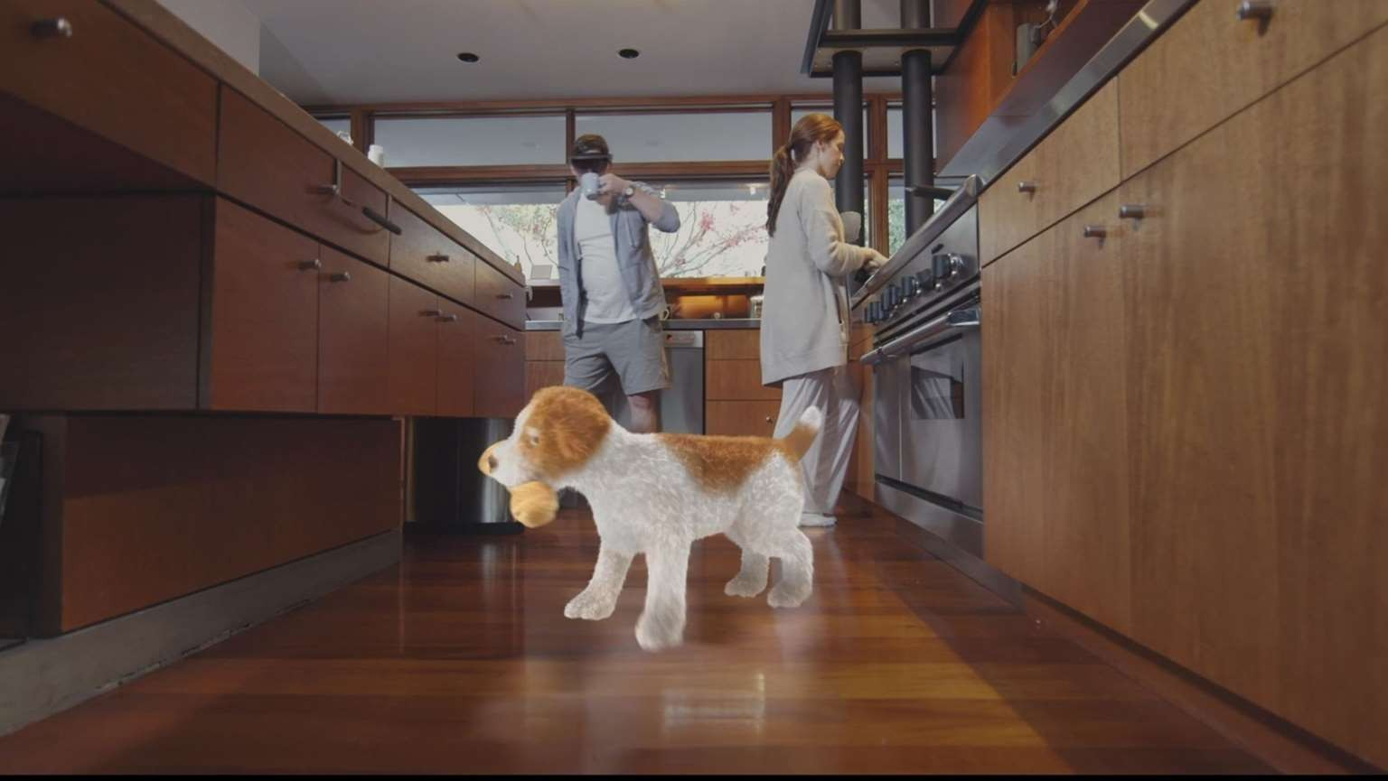



Slide 13




Slide 14
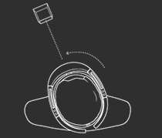
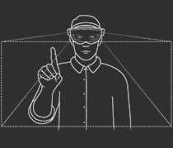
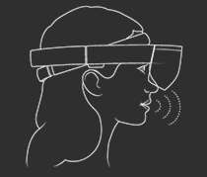
Input diversity
Holographic
Immersive
Gaze tells you where the user is looking in the world and lets you determine their intent.
☑
☑
Gesture input lets you interact with your holograms naturally using your hands or a clicker.
☑
Game pads – Navigate, target, scroll, zoom, select.
Mouse and keyboard: Point, click, text input.
☑
☑
Voice allows you to directly command a hologram without having to use gestures. You simply gaze at a hologram and speak your command.
☑
☑

Slide 15
Universal Windows Platform

Slide 16
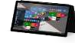

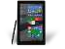
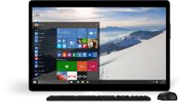
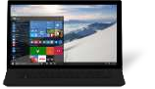
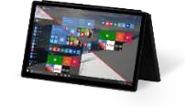

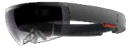
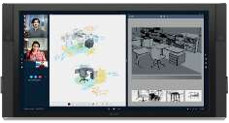
UWP
Mobile
Common API surface across all devices
One Universal Store Apps are packaged using
.Appx Format
Extension SDKs for device optimization
Desktop*
Xbox
Holographic
Hub
*In Devcenter, Immersive headset experiences are desktop experiences, not Holographic

Slide 17
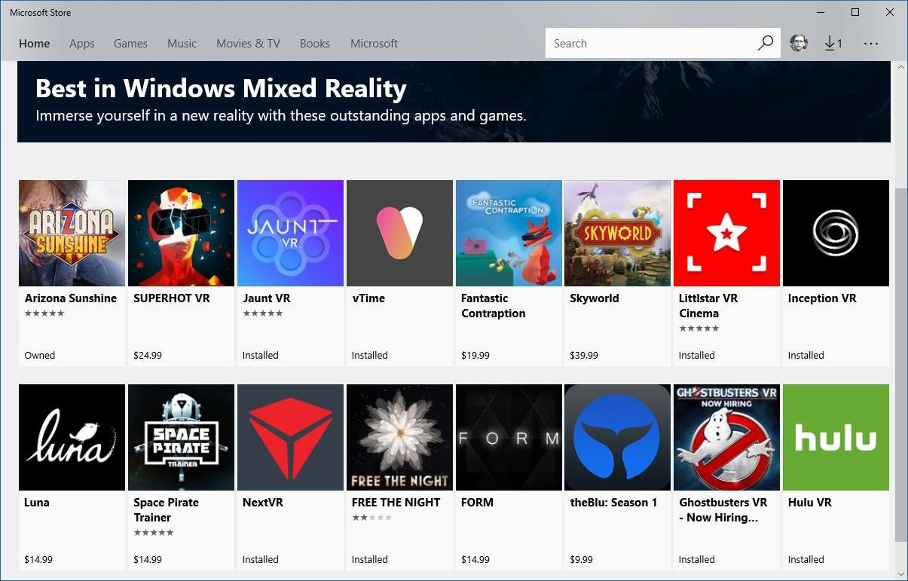
Goal: High quality MR apps in our store

Slide 18
Mixed Reality Toolkit

Slide 19
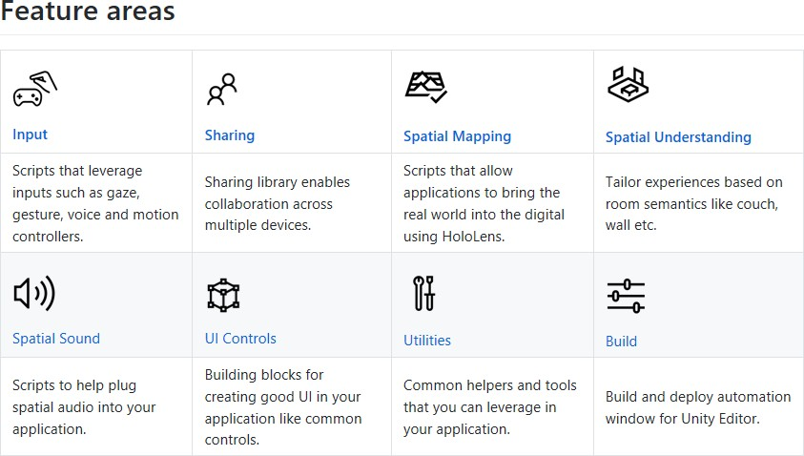
https://github.com/Microsoft/MixedRealityToolkit-Unity

Slide 20
Developer Setup

Slide 21
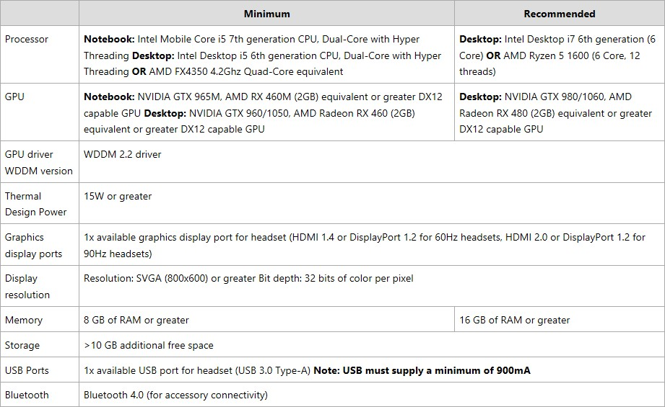
Developer Hardware

Slide 22
Developer Software
Windows 10 Fall Creators Update (RS3)
OS > 16299.15
Visual Studio 2017 Update 3 or 4
Unity 2017.2 latest version
Do not use Unity 2017.3
Windows SDK (16299)
https://developer.microsoft.com/en-us/windows/downloads/windows-10-sdk
Mixed Reality Toolkit –Unity (optional)
https://github.com/Microsoft/MixedRealityToolkit-Unity

Slide 23
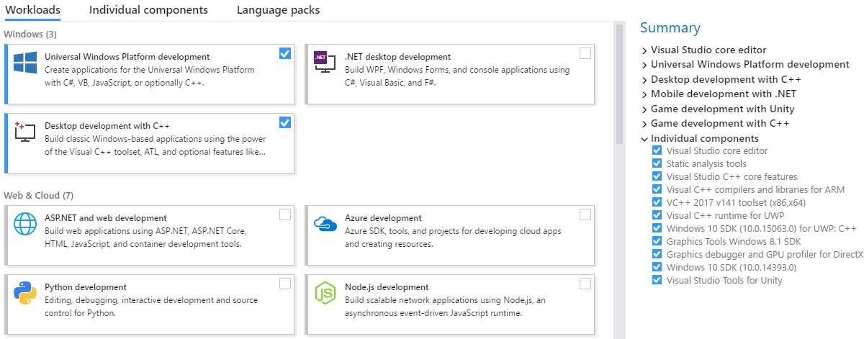
Visual Studio Setup for IL2CPP
IL2CPP = Intermediate Language to C++
Unity technology for compiling .NET assemblies (that contain IL) to native platforms. It is comprised of an ahead of time (AOT) compiler and runtime services. It is worth mentioning that the compiler is AOT simply to distinguish it from normal .NET assemblies that are compiled just in time (JIT).

Slide 24
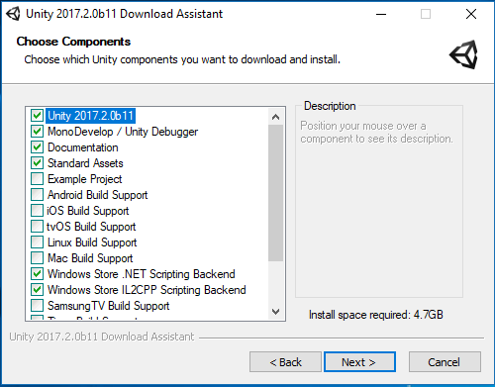
Unity Setup Options

Slide 25
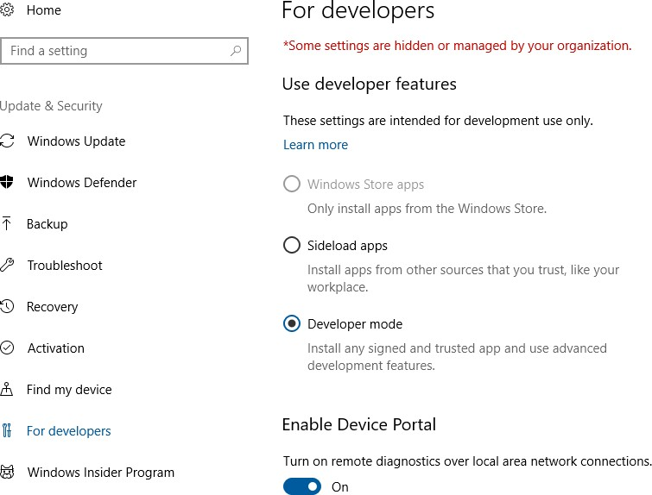
Developer Unlock
Settings → Update & Security→ For Developers

Slide 26
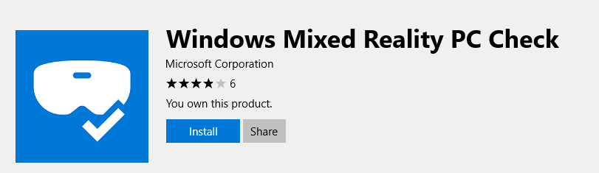
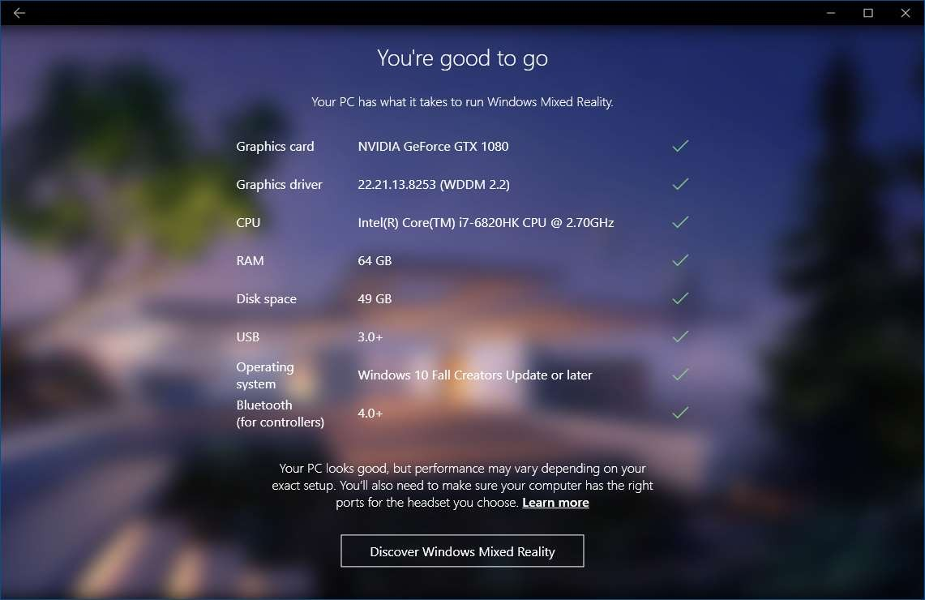
Windows Mixed Reality PC Check

Slide 27
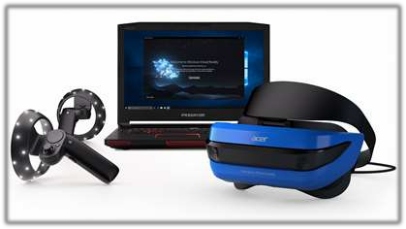
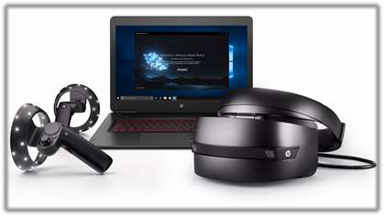
Development Headsets
Hardware details for development edition devices from Acer and HP
Two high-resolution LCD at 1440 x 1440
2.89” diagonal display size (x2)
Front hinged display
95° horizontal field of view
Display refresh rate up to 90 Hz (native)
Built-in audio out and microphone support through
3.5mm jack
Single cable with HDMI 2.0 (display) and USB 3.0 (data) for connectivity
4.00m/0.60m removable cable
Inside-out tracking

Slide 28
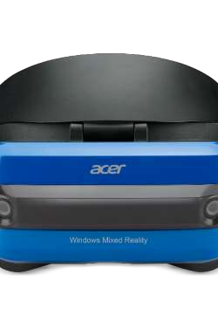
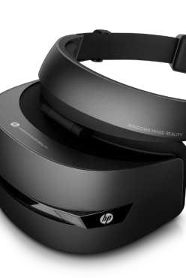
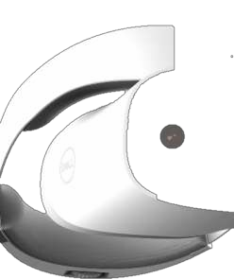
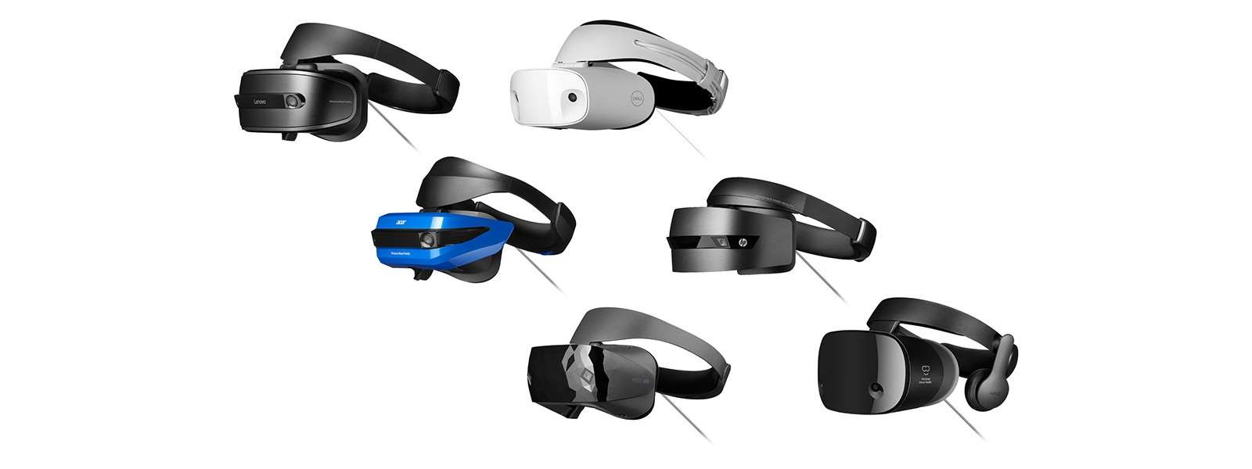
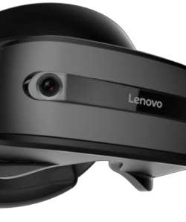
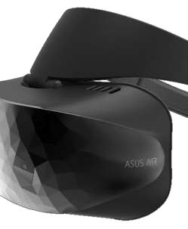






Headsets
Powered by
Windows Mixed Reality

Slide 29
Headset Specs
 | Acer | Lenovo | Dell | HP | Samsung
Resolution | 1440x1440 (per eye) | 1440x1440 | 1440x1440 | 1440x1440 | 1440x1600 (AMOLED)
Refresh Rate | 90Hz | 90Hz | 90Hz | 90Hz | 90Hz
Field of View | 95° | 110° | 110° | 95° | 110°
Diagonal Size | 2.89” | 2.89” | 2.89” | 2.89”
Speakers | 3.5mm jack | 3.5mm jack | 3.5mm jack | 3.5mm jack | Integrated headphones
Mic | 3.5mm jack | 3.5mm jack | 3.5mm jack | 3.5mm jack | Dual array
6DoF Inside Out | √ | √ | √ | √ | √
Cable | 4m | 4m | 4m | 4m | 4m
https://developer.microsoft.com/en-us/windows/mixed-reality/immersive_headset_hardware_details

Slide 30
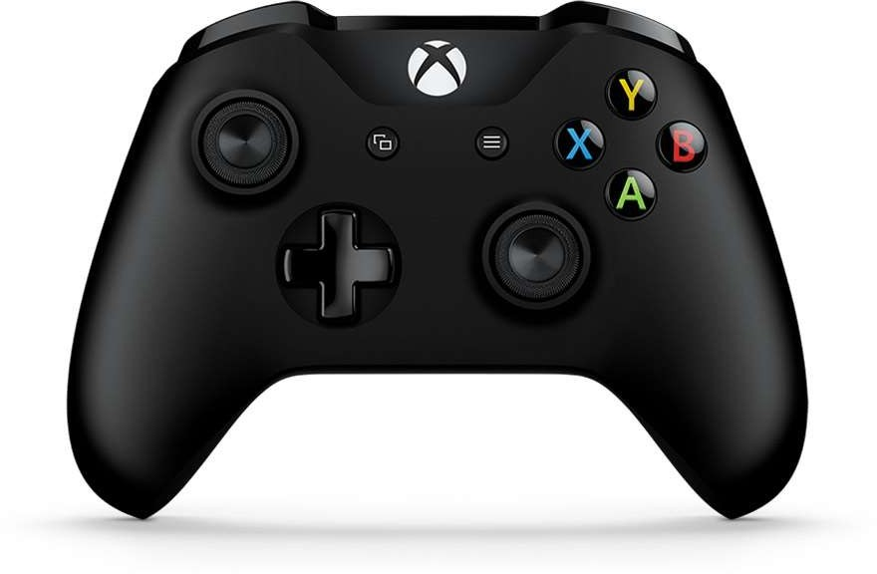
Xbox Controller

Slide 31
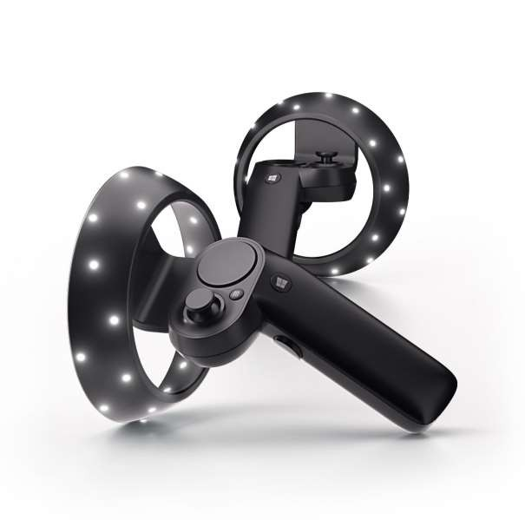
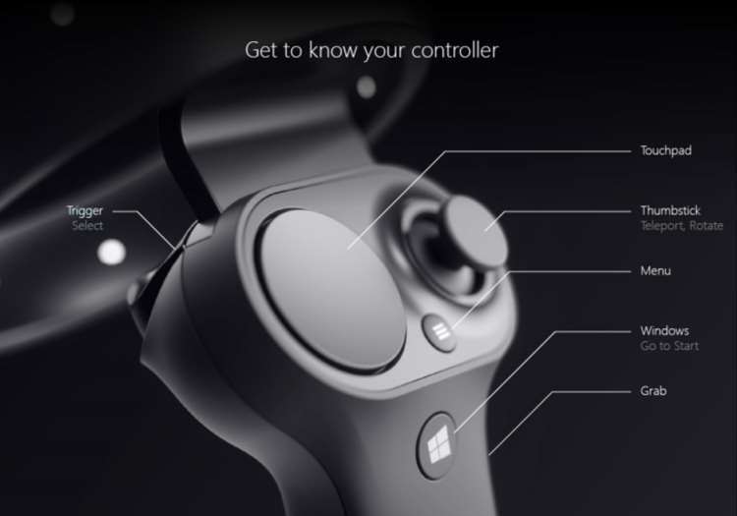
Motion Controllers
Optical Tracking - Bluetooth 4.0 or USB

Slide 32
Mixed Reality Portal

Slide 33
Mixed Reality Portal
Demo

Slide 34
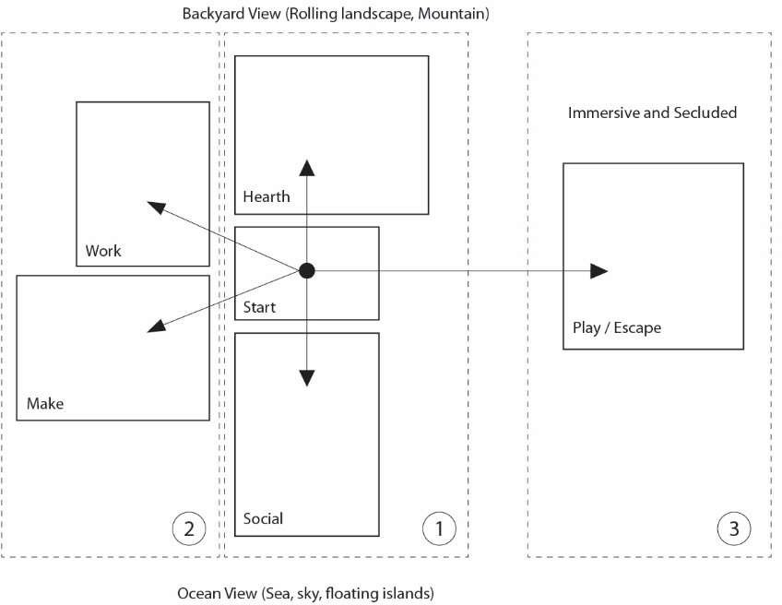
Cliff house
Microsoft Confidential – Ensure you have read Cliff House doc in References

Slide 35
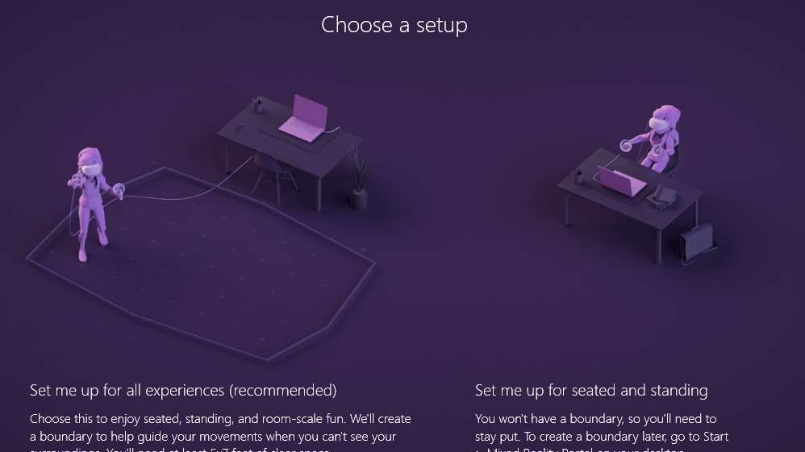
Room Setup

Slide 36
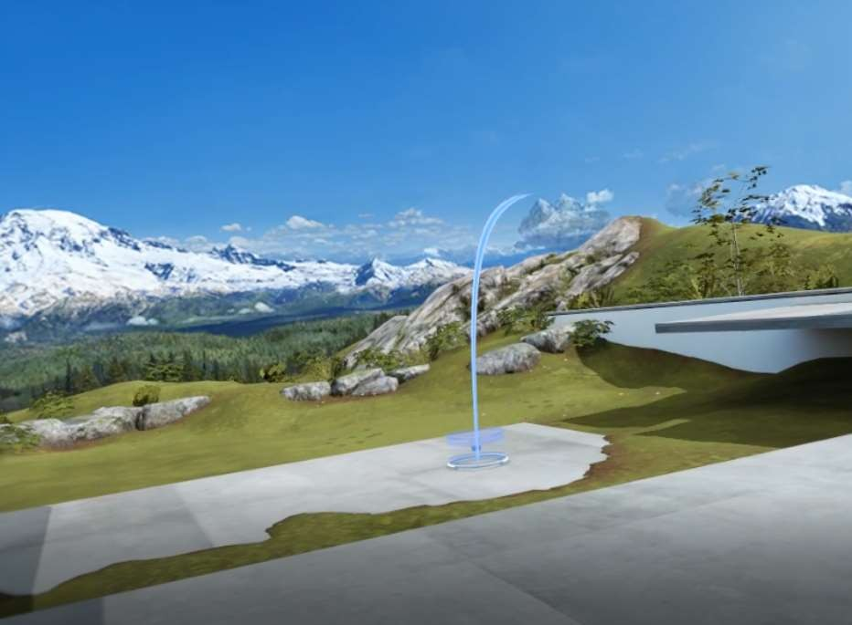
Cliff House
Teleport
1. Bring up reticle
Motion Controller : Thumbstick forward Xbox Controller : Left Thumbstick forward Mouse : Right click
Place reticle at target location Motion Controller : Tilt
Xbox Controller : Gaze Mouse : Move mouse
Teleport
Motion Controller : Release thumbstick Xbox Controller : Release thumbstick Mouse : Release button
Move
Motion Controller : Tap thumbstick left/right Xbox Controller : Right thumbstick left/right Mouse : Move and click
Select
Motion Controller : Trigger Xbox Controller : A button Mouse : Left click
Start Menu
Motion Controller : Windows button Xbox Controller : Xbox button Keyboard : Windows key

Slide 37
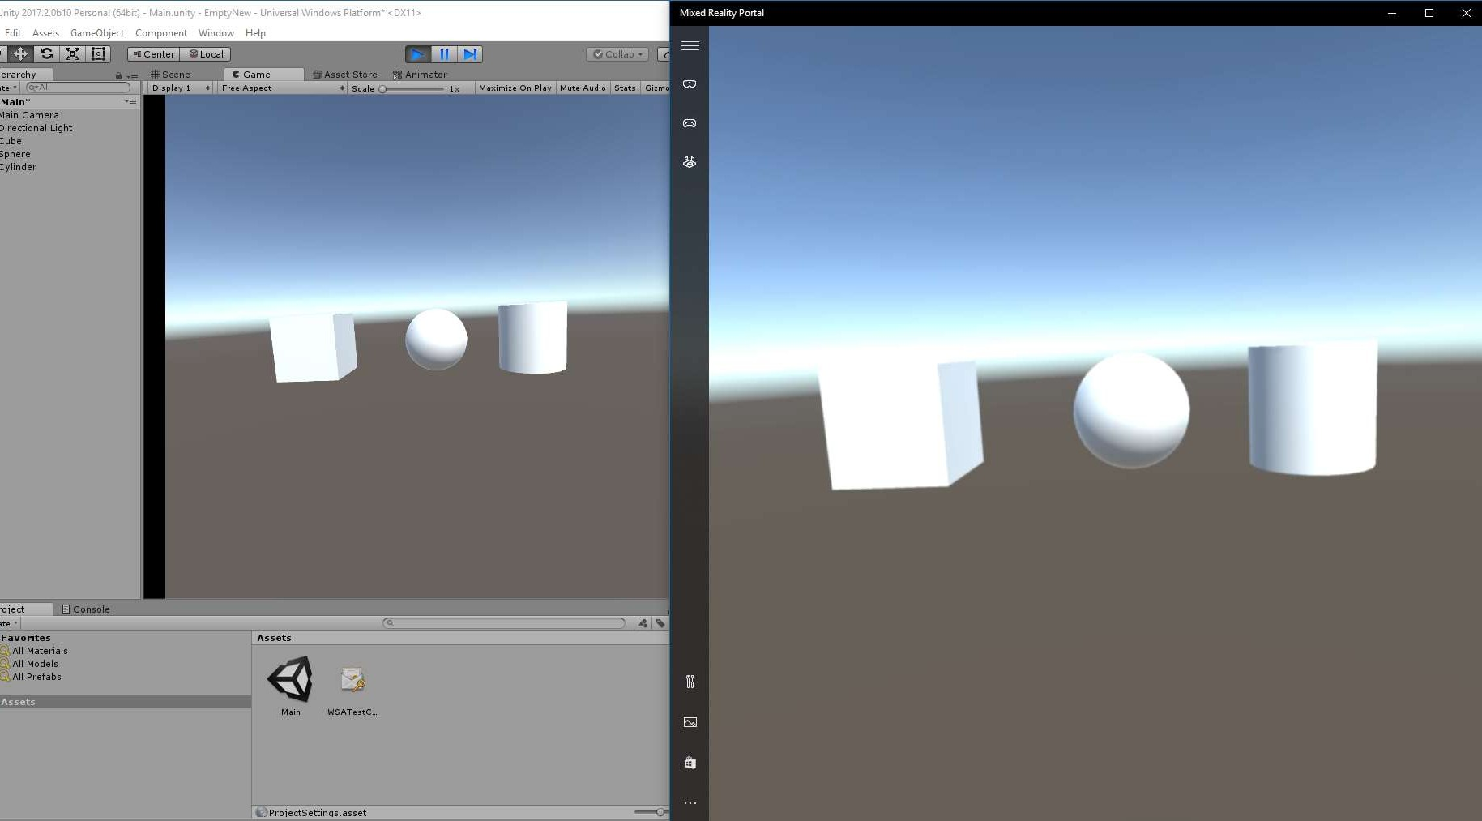
Unity Play Mode

Slide 38
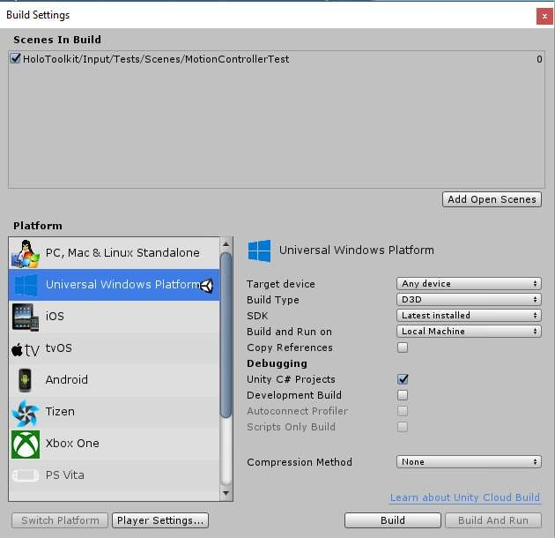


Build Settings
* Single Pass for stereo will improve performance and is recommended, but test thoroughly any shaders and custom rendering scripts
Color space - Gamma
*Today, XAML Build Type is nor supported for immersive projects

Slide 39
Developing with Visual Studio

Slide 40

Visual Studio Configuration
Master
What you submit to the store No debug, no profiling
.NET Native: longer compilation
Release
No debug, profiling,
Does not use .NET native
Debug
Debug, profiling, safety checks

Slide 41

Deploying solution
Deploy solution so you can launch it from Windows Mixed Reality Portal, without needing Visual Studio

Slide 42
Resources

Slide 43
Docs & forums
Product documentation
https://aka.ms/mr
Forums
https://forums.hololens.com https://forum.unity.com/forums/windows.50/
DevCenter Support
https://developer.microsoft.com/en-us/windows/support

Slide 44
Samples
Mixed Reality Toolkit
https://github.com/Microsoft/MixedRealityToolkit-Unity
Mixed Reality Design Labs
https://github.com/Microsoft/MRDesignLabs_Unity
Dynamic Quality Level based on FPS and HMD connectivity handler
https://github.com/vladkol/UnityMRHMDLife
UWP Background File Downloader in Unity
https://github.com/vladkol/UnityUWPBackgroundDownloader

Slide 45


